Slide 1
The New Wave of Home Care
PREMIER HOME HEALTH CARE SERVICES

Slide 2
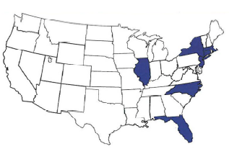
We Are Premier
Established in 1992 and Headquartered in NY
Operates in 7 states: NY, NJ, CT, MA, IL, NC and FL
Provide Licensed Home Care, Care Management, Nursing Assessments, and Community Based Technology Services
Service approximately 34,000 long term and acute care members monthly
Premier maintains a comprehensive community based service delivery platform:
Personal Care Aide Services
Aide driven Real-Time Data (RTD) for VBP and patient health outcome management
Private Duty RN / LPN Services
Transitional Care
Premier Clears America Program – Population Health Management and Screenings

Slide 3
Leveraging Our Greatest Assets
Through the use of advanced training and real-time data technology in the home, Premier has redefined the way we provide home care for our members, becoming the front line of population health management.
Key components of this comprehensive service delivery model:
Home Health Aides are the “Eyes and Ears in the Home”
Incorporating technology to maximize the “value contribution” of the Aide in the home
Obtaining and analyzing data from the home for outcome management
Data driven clinical & care management interventions, building industry best practices
Program Goals:
Increase Performance on Payer Quality Measures and Improve Patient Outcomes
Reduce Emergency Department (ED) and Hospital Events
Reduce overall cost of care
The key is leveraging the value of the aide in the home and their ability to observe and transmit both vital sign data and subtle changes in member status through a Chromebook or other mobile device to effectuate improved outcome management.
Notes:
As the healthcare industry has continued to shift its focus to Value Based Care, Premier has developed its Real-Time Data Platform in an effort to redefine our home care delivery. The key to the program is utilizing home care workers as the “Eyes and Ears” in the home – collecting invaluable information and streamlining the process of getting that data, in real-time, to the health care professionals who need it to make appropriate care plan adjustments and implement critical interventions to improve patient’s health outcomes.
We had a few goals when building out Real-Time Data, the first was to develop a sustainable VBP platform that drives improvement to patient health outcomes and that gave us a vehicle for participating in these types of arrangements with payers. The second, helping our contracted partners achieve their goals in Improving their quality measures and patient outcomes. Third – keeping our patients safely at home, in the community, and helping them to reduce avoidable hospital related events. Finally, a strong effort to reduce the overall cost of care. However, I think the overarching goal of the program was to align our platform with the evolving industry standards to help support NYS quality initiatives and drive policy changes to improve our health care delivery.

Slide 4
Premier Real-Time Data - A 3-Pronged Approach
Premier’s Real-Time Data (RTD) home care model is made up of three critical components: Training, Data Collection, and Data Management. Together, these pieces have allowed Premier to succeed in VBP arrangements and improve patient health outcomes.
Enhanced Training Focused on Patient Health Outcomes
Observe, Ask, Report (OAR) - Disease specific & technology specialty training
Development of the GAP Aide Program (WIO Dollars at Work)
Data Collection and Transmission Utilizing Technology from the Home
OAR Telephony Alert System
WebOAR+
Dashboard Management for Population Health
Targeted measure monitoring for clinical/care management interventions and improved outcomes
Promoting & facilitating Interdisciplinary Team (IDT) interactions: Collaborative approach to care
Data aggregation for improving Population Health & Cost Reduction
Notes:
Premier’s Real-Time Data Platform takes on a three pronged approach by incorporating Enhanced Training, Optimized Data Collection, and key aspects of Population Health Management to improve patient health outcomes. Nini will go into further details about each prong shortly, but to give you a quick overview…
The first piece is our comprehensive training curriculum, which we call Observe, Ask, and Report or “OAR”, it aligns both field and office staff’s on-going education with the state’s policies and quality improvement initiatives and expands our workforce’s capabilities and has helped provide them insight into how their individual roles factor into a larger healthcare system. As part of this, we developed the GAP Aide program – which, through the use of higher levels of training, has built out a career ladder for our aides within their current scope of work. The GAP Aide is utilizing technology in the home to report, in real-time changes in the patient’s conditions.
The second key component is our Data Collection and Transmission – once our staff our trained, we needed a way to gather that data and quickly get it back to the office to share with patient stakeholders. Rob – has done a tremendous job of developing two modes of data collection – our OAR telephony system and WebOAR+, web-based platform which expands on the data collected through the telephony system.
The third piece, is the Dashboard Management and Population Health, this prong is what closes the loop of information from the home to the LHCSA team, and back to the Care Managers at the Health Plan. Actively reviewing all of the data points that come in from the field, acting to apply interventions or facilitate an IDT with real-time information is critical to improving patient health outcomes.

Slide 5
RTD Dashboard Management for Population Health
Comprehensive data and streamlined collection are only the beginning. It is critically important to have a structured process to apply real-time information and drive data-informed decisions.
Targeted measure monitoring to facilitate and provide oversight of patient care
Best practice work flows that ensure timely and appropriate follow up to changes in patient needs
QIM and PAH Alert Tracking
Medication compliance and medication refill tracking
Physician and specialist visit tracking
Satisfaction Initiatives
Disease Specific Interventions and targeted education library
Triage and severity analysis of patient’s deteriorating conditions
Encourage and track vaccinations (COVID, Flu, pneumococcal, shingles, etc.)
Defined roles within the Interdisciplinary Team (IDT) model for a collaborative approach to care
Facilitate Interdisciplinary Team Meetings
Support appropriate triage and data informed interventions
Notes:
Now, what do we do with the data that we collected.
RTD’s third prong closes the loop on Population Health management by bringing all of this invaluable data from the home to the LHCSA care team to facilitate an IDT with the Health Plan Care Managers for early patient outcome interventions
The automated transmission of the alert triggers provided by the aides are then funneled to our RTD Dashboard.
Best practices are built out in our dashboard and provides workflows for all of our staff to follow and address the reported alert triggers to resolution..
Our RTD dashboards serves as a system to track and monitor processes and steps that the service coordinators, field nurse supervisors, and aides need to follow to assess and address the patient’s change in condition and
when to triage the issue to the appropriate health care providers/facility to prevent unnecessary hospitalization or ED utilization.

Slide 6
RTD Dashboard Management for Population Health
Collection of real-time information about a specific patient or population over time provides invaluable insight into their disease specific needs allowing for the development of industry best practices and the integration of home care into value based payment arrangements.
Data aggregation for improving Population Health & Cost Reduction Aggregation and Analysis of Real-Time-Data
Enforce timely follow up and resolution for reported new or worsening changes in the RTD Dashboard
Provide teams with prominent issues and patient-specific trends in negative health outcomes and medication adherence
Ensure intervention is initiated to improve patient health outcomes
Predictive analytics for population trends
Trends across Health Plans and Hospital Systems
Best practices for disease-specific interventions
Impact of social determinants and other community variables on patient health and total cost of care outcomes
Notes:
Once all of the data has come out of the home and into the dashboard, the process then goes through our population health management process, where we look to analyze and aggregate this invaluable data. This allows for Premier to continue expanding on quality improvement initiatives for our LCHSA service delivery and improve our performance measures in our current 10 VBP II arrangements.
Data are managed in the Dashboard by our Premier Quality Improvement team daily to ensure timely resolutions
Data used to understand best practices and to improve our performances
Data outcomes used by all members of the IDT and Quality team to expand on quality improvement initiatives, and develop enhanced trainings
Premier has started working on predictive analytics as a result of the data collection process Nini just walked you through. Through machine learning, Premier aims to start identifying when a patient’s health is declining, allowing our Pop Health team to host an IDT to wrap services around this patient to avoid any Hospital related event. This type of analysis also incorporates external interventions, like CBO supports from organizations like AirNYC or GOD’s love we deliver (Healthy food delivery for Diabetes and HTN) , coupled with in-home aide can help drive down the total cost of care for a Health Plan.

Slide 7
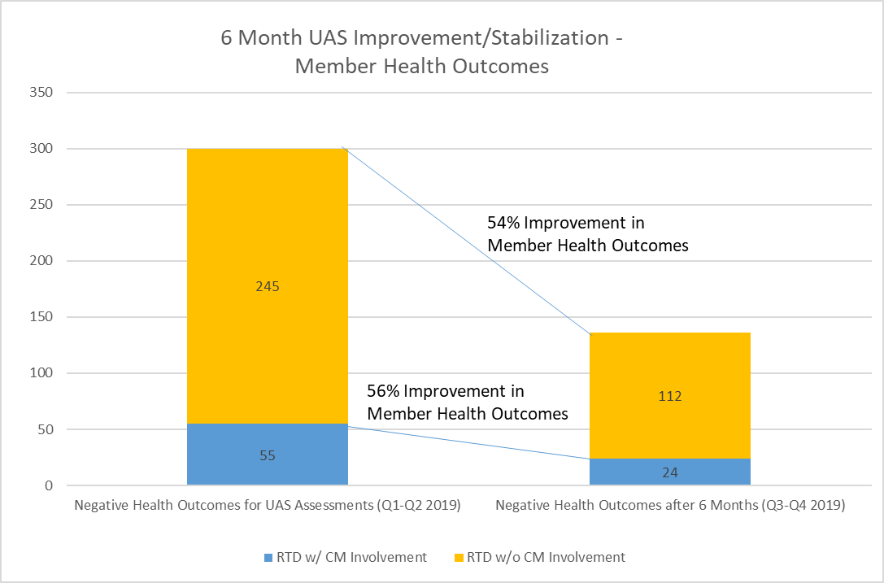
Member Improvement Due to Real-Time Data
This data set analyzes the UAS assessment results for a cohort of 246 members over a 6 month period.
This data set follows 37 high risk members who received Premier follow up and intervention with direct Care Management involvement. The 37 high risk members reported 55 negative health outcomes in their first 2019 UAS assessment and only reported 24 reoccurring negative health outcomes 6 months later.
This data set also follows 209 standard risk members who received Premier follow up and intervention without direct CM involvement. The 209 members reported 245 negative health outcomes in their first 2019 UAS assessment and only reported 112 reoccurring negative health outcomes 6 months later.

Slide 8
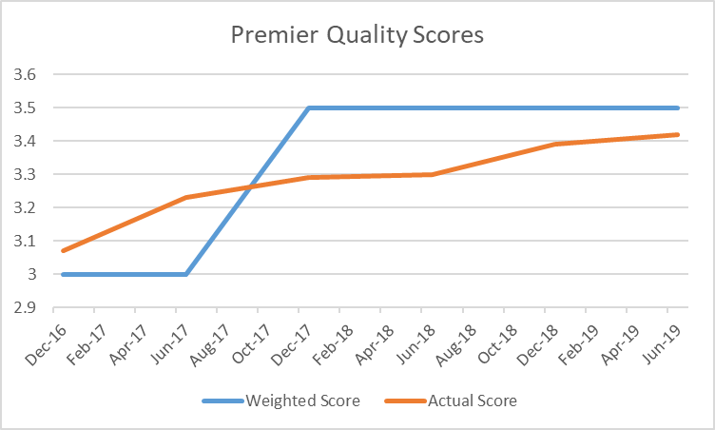
Premier’s 2016-2019 Quality Scores with One NY MLTC
Note: The above data is based on NYS DOH UAS data.

Slide 9
Long Island Offices:
Contact Information:
Connect with us on Social Media!
Premier Home Health Care - Licensed Counties
Branch: | Riverhead | Ronkonkoma | Westbury - Priority
Contact Person: | Emma Morais | Emma Morais | Aimee Biernacki
Phone #: | 631-591-3955 | 631-979-8009 | 516-292-1500
Fax #: | 631-591-3953 | 631-863-1970 | 516-292-3917
Counties: | Suffolk | Suffolk | Nassau
 |  |  | Suffolk
Facebook: https://www.facebook.com/premierhomehealthcare
Instagram: https://www.instagram.com/premierhomehealthcare
LinkedIn: https://www.linkedin.com/company/premier-home-health-care-services-inc
Pinterest: https://www.pinterest.com/premierhomehealthcareservices/
YouTube: https://www.youtube.com/channel/UCWYN83fGP1HvquOLoZhqnwQ/
If you would like to learn more about our comprehensive service delivery platforms, contact us today!
We look forward to hearing from you!

