Slide 1




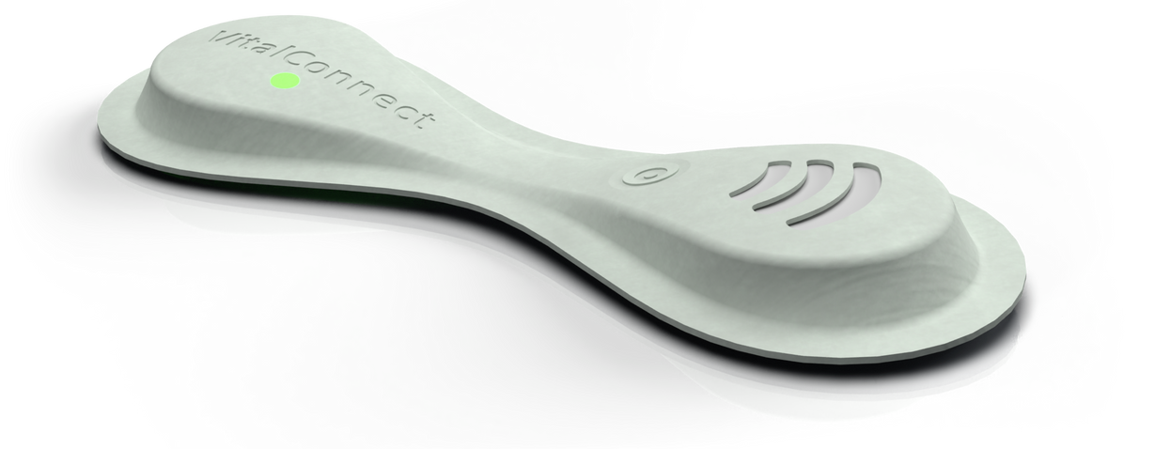

Every signal. Every Second.
Remote Cardiac
Solutions

Slide 2


VitalPatch
PAGE 4
VistaCenter with Live Look-In
PAGE 6
EHR Integration
PAGE 8
Cardiac Monitoring
PAGE 11
Remote Patient Monitoring
PAGE 12
CPT Codes &
Disclaimers
PAGE 13
Table of Contents

Slide 3




VitalPatch®

Slide 4



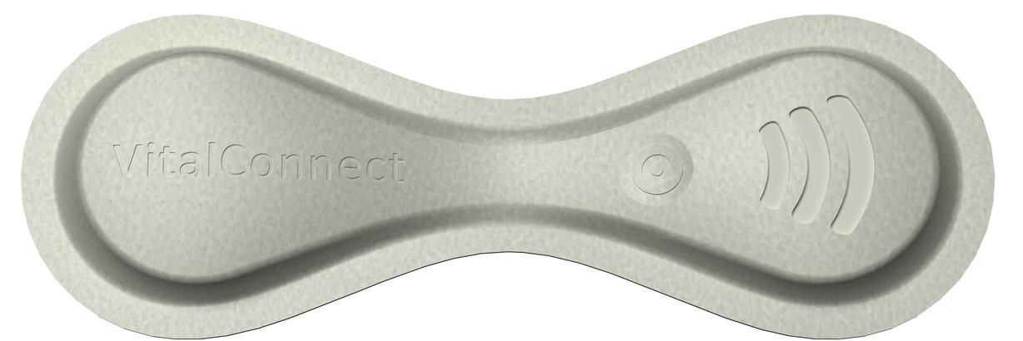


Built for Professionals. Made for Patients.

Slide 5




VitalPatch
Our single-use biosensor helps clinicians deliver better cardiac care with the detection of key vital signs³ comfortably and continuously, in any setting⁴, for up to 30 days.^{1,5}
One Patch.
Multiple Modalities.
4-in-1 cardiac monitor
User-friendly experience & comfortable for patients
FDA-cleared & performance tested^{1,4}
Continuously captures patient data⁵ for multiple modalities in one device — including Mobile Cardiac Telemetry (MCT), Extended Holter and Event.
The lightweight, disposable patch eliminates hassle — so patients can wear and go about life with confidence.
Wearable technology that assists physicians confidently care for their patients.⁶

Slide 6

VistaCenterTM
with Live Look-InTM

Slide 7

VistaCenterTM
with Live Look-InTM
Stay Connected
to What’s Vital.
Physicians can monitor multiple patients from rhythm to resolution with customizable alerts, user preferences, and full EHR integration — without waiting for patch returns.^{1,4,5}
Historical Trends
Actionable insights with access to historical data — no gaps, no guesswork, just clarity.
Secure Live Data with Look-In^{3,4,5}
Available visibility to live patient data through
a secure URL for timely intervention.
Track Patients Anywhere^{3,4,5}
No matter the modality, live and historical patient data is viewable on various devices.

Slide 8

EHR
Integration

Slide 9

EHR
Integration
Smart Data. Streamlined Care.
Help close the gap between patient monitoring and clinical decision-making, including bidirectional workflows to enable seamless collaboration, timely alerts, and reduced administrative burden—all within your existing systems.
Compatible with Major EHR Systems
Including Epic®, Oracle® (formerly Cerner®), Meditech®, and other top systems⁷ —eliminating the need for manual data transfers or extra logins.
Bi-Directional Data Exchange
Available visibility to live patient data through
a secure URL for timely intervention.
VistaCenter™- Enabled Integration
Customizable and ready to grow with your organization.
Built by Experts, Backed by Experience
With 30+ years of healthcare IT experience, our team builds customized, compliant, secure, and scalable solutions.

Slide 10

Services

Slide 11

Cardiac
Monitoring
Supporting Healthcare Professionals with Cardiac Care.
By using VitalPatch and VistaCenter, VitalConnect® provides a fully integrated 4-in-1 cardiac monitoring and reporting⁸ service for Mobile Cardiac Telemetry (MCT), Extended Holter (EH) and other monitoring types.
This combination of unique wearable and viewing technology supports healthcare professionals in what matters the most — delivering data needed to assist in providing positive patient outcomes through the detection of 4 key vital signs³:
Heart Rate
Heart Rate Variability
Respiratory Rate
Activity

Slide 12
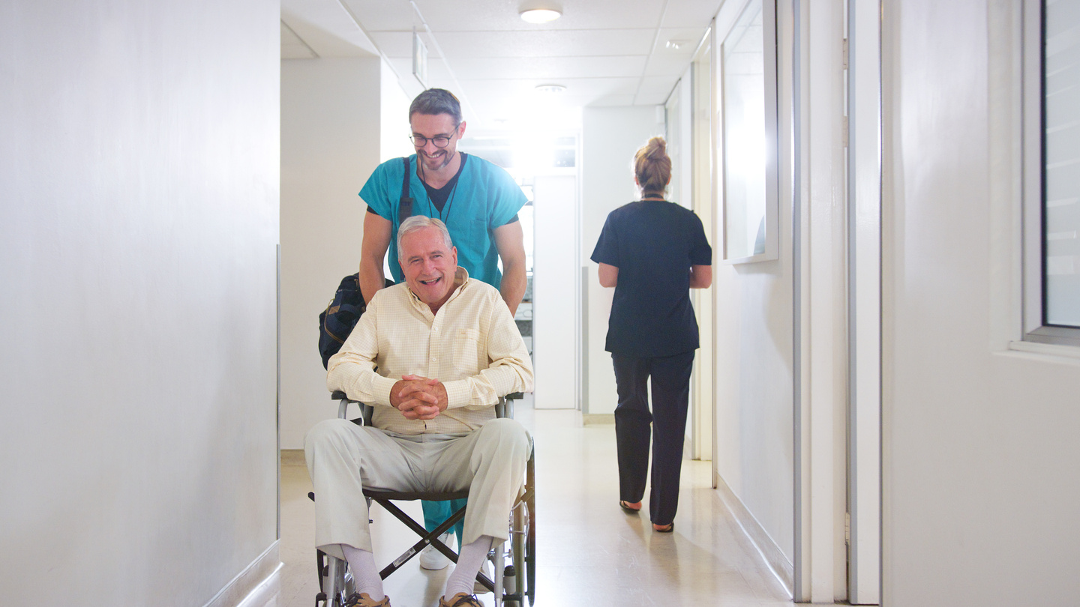



Remote Patient Monitoring
Constant Clarity. Wherever Care Goes.
Our solutions are built to help keep clinicians connected and patients protected — whether they're in the hospital, at home, or anywhere in between.⁴
With continuous cardiac data, seamless integration, and a single biosensor across all modalities, we can deliver insights that are fast, clean and smart^{4,5} with:
Inpatient Expansion
Hospital at Home
Hospital-Grade Accuracy, Anywhere⁵
Customized Alerts, Live Oversight³
Simplified Deployment & Self-Application
Scalable, Cost-Efficient Care⁹
Streamlined Solution
Clinical Trials

Slide 13

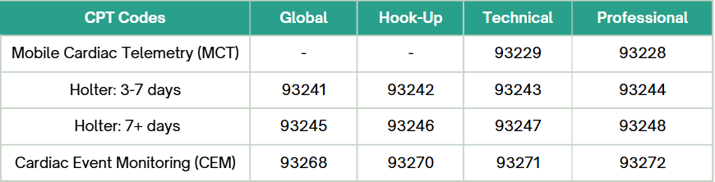
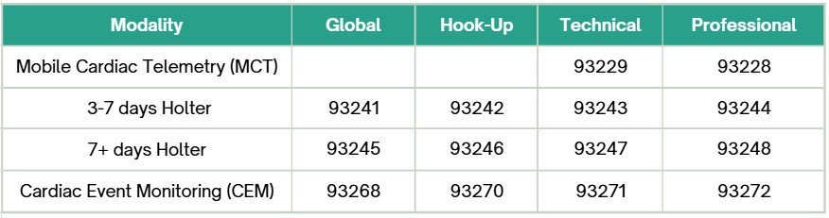

CPT Codes¹⁰
Data on file. VitalConnect 2025.
Per Physician's MCT/CEM Notification Criteria
In the detection of key vital signs with Live Look-In™ ECG.
VitalConnect solutions are intended to be used for outpatient cardiac telemetry and in-patient monitoring (Remote Patient Monitoring only) in non-critical healthcare settings for non-urgent clinical decision-making.
May be affected by data transmission. Potential transfer data interruptions are listed in the IFU.
FDA-cleared for adult patients 18 and up.
All trademarks, logos, and brand names are the property of their respective owners. Use of these names, trademarks, and brands does not imply endorsement.
Proprietary third-party artificial intelligence (AI) software detects 20 unique cardiac arrhythmias.
Levine DM, Ouchi K, Blanchfield B, Diamond K, Licurse A, Pu CT, Schnipper JL. Hospital-Level Care at Home for Acutely Ill Adults: a Pilot Randomized Controlled Trial. J Gen Intern Med. 2018. May;33(5):729-736. doi: 10.1007/s11606-018-4307-z. Epub 2018 Feb 6. PMID: 29411238; PMCID: PMC5910347.
Information contained in this publication is not to be construed as legal or billing advice. CPT® is a registered trademark of the American Medical Association. All CPT® information provided in this publication is intended for illustration purposes only, and should be independently verified prior to billing application.

Slide 14
Thank You!
VitalConnect, Inc.
2870 Zanker Road, Suite 100
San Jose, CA 95134
www.vitalconnect.com
©2025 VitalConnect. All trademarks are property of VitalConnect, Inc. | MKT-261 Rev A

